Slide 1
JSON JavaScript Object Notation
An introduction to JSON
Lecturer: Jackie Stewart
Email : jackiestewart@ait.ie
jackie.stewart@tus.ie

Slide 2
JSON
JSON (JavaScript Object Notation) is a lightweight data-interchange format
JSON code is valid JavaScript
JSON is a text format that is completely language independent
JSON is built on two structures:
A collection of name/value pairs
An ordered list of values
JSON file extension: *.json

Slide 3
JSON is….
A lightweight text based data-interchange format
Completely language independent
Based on a subset of the JavaScript Programming Language
Easy to understand, manipulate and generate

Slide 4
JSON is NOT….
Overly Complex
A “document” format
A markup language
A programming language

Slide 5
Why use JSON ?
Straightforward syntax
Easy to create and manipulate
Can be natively parsed in JavaScript using eval()
Supported by all major JavaScript frameworks
Supported by most backend technologies
Notes:
eval() is a function property of the global object.
The argument of the eval() function is a string.
If the string represents an expression, eval() evaluates the expression….
Do not call eval() to evaluate an arithmetic expression; JavaScript evaluates arithmetic expressions automatically.

Slide 6
JSON Object Syntax
Unordered sets of name/value pairs
Begins with { (left brace)
Ends with } (right brace)
Each name is followed by : (colon)
Name/value pairs are separated by , (comma)

Slide 7
Simple JSON Example
Each name is followed by : (colon)
Each Name/value pairs are separated by , (comma)
var employeeData = {
"employee_id": 1234567,
"name": "Jeff Fox",
"hire_date": "1/1/2013",
"location": "Norwalk, CT",
"consultant": false
};

Slide 8
Arrays in JSON
What is an Array?
An ordered collection of values
Begins with [ (left bracket)
Ends with ] (right bracket)
Name/value pairs are separated by , (comma)

Slide 9
JSON Object Syntax
var employeeData = {
"employee_id": 1236937,
"name": "Jeff Fox",
"hire_date": "1/1/2013",
"location": "Norwalk, CT",
"consultant": false,
"random_nums": [ 24,65,12,94 ]
};
An ordered collection of values within a JSON representation

Slide 10
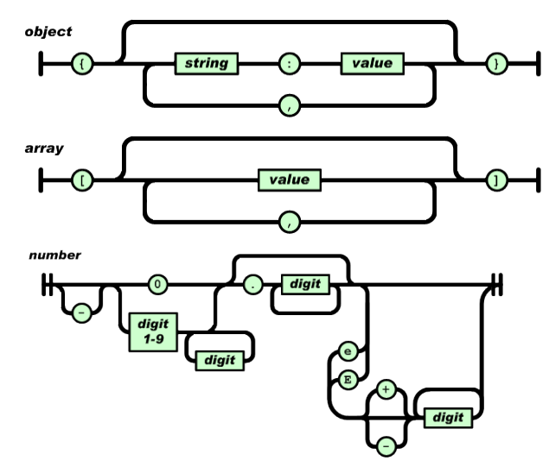
JSON: Object, Array, Number

Slide 11
XML vs JSON
Comparing and Contrasting

Slide 12
Representing XML in JSON
JSON
The following JSON example defines an employees object, with an array of 3 employee records:
{"employees":[ {"firstName":"John", "lastName":"Doe"}, {"firstName":"Anna", "lastName":"Smith"}, {"firstName":"Peter", "lastName":"Jones"} ]}
<employees>
<employee>
<firstName>John</firstName>
<lastName>Doe</lastName>
</employee> <employee>
<firstName>Anna</firstName>
<lastName>Smith</lastName>
</employee>
<employee>
<firstName>Peter</firstName>
<lastName>Jones</lastName>
</employee>
</employees>

Slide 13
XML is much like JSON because…
Both JSON and XML is "self describing" (human readable)
Both JSON and XML is hierarchical (values within values)
Both JSON and XML can be parsed and used by lots of programming languages
Both JSON and XML can be fetched with an XMLHttpRequest

Slide 14
XML is unlike JSON because….
What is the meaning of parsed
The biggest difference is:
XML can only be parsed with an XML parser,
JSON can be parsed by a standard JavaScript function.
JSON doesn't use an end tag
JSON is shorter
JSON is quicker to read and write
JSON can use arrays

Slide 15
Resources
JSON.org: http://www.json.org/
JSON – Introduction JSON Introduction (w3schools.com)

